Slide 1
Prediction of Job Change
Group 1
Renping Ge, Yuchen Ma, Zongzhu Li

Slide 2

Outlines
Introduction
Exploration Data Analysis
Data Preprocessing
Modeling and Prediction
Logistic Regression
Random Forests
Histogram based Gradient Boosting
Modeling Evaluation
Features Importance
Summary and Discussion

Slide 3

Introduction
Exploring the probability of a candidate to look for a new job or will work for the company after training
Interpreting affected factors on employee decision

Slide 4
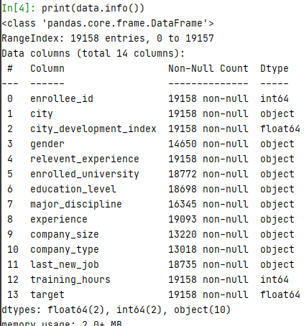
Dataset Description
This dataset, provided by kagle, is collected by the company and designed to understand the factors that lead a person to work for the company(leaving their current job).
19158 entries and 14 columns including features variables and target variable.

Slide 5
Dataset Description - Features and Target
enrollee_id: Unique ID for enrollee.
city: City code.
citydevelopmentindex: Development index of the city (scaled).
gender: Gender of enrollee.
relevent_experience: Relevant experience of enrollee.
enrolled_university: Type of University course enrolled if any.
education_level: Education level of enrollee.
major_discipline: Education major discipline of enrollee.
experience: Enrollee total experience in years.
company_size: No of employees in current employer's company.
company_type: Type of current employer.
last_new_job: Difference in years between previous job and current job.
training_hours: training hours completed.
target:
0 – Not looking for job change,
1 – Looking for a job change.

Slide 6
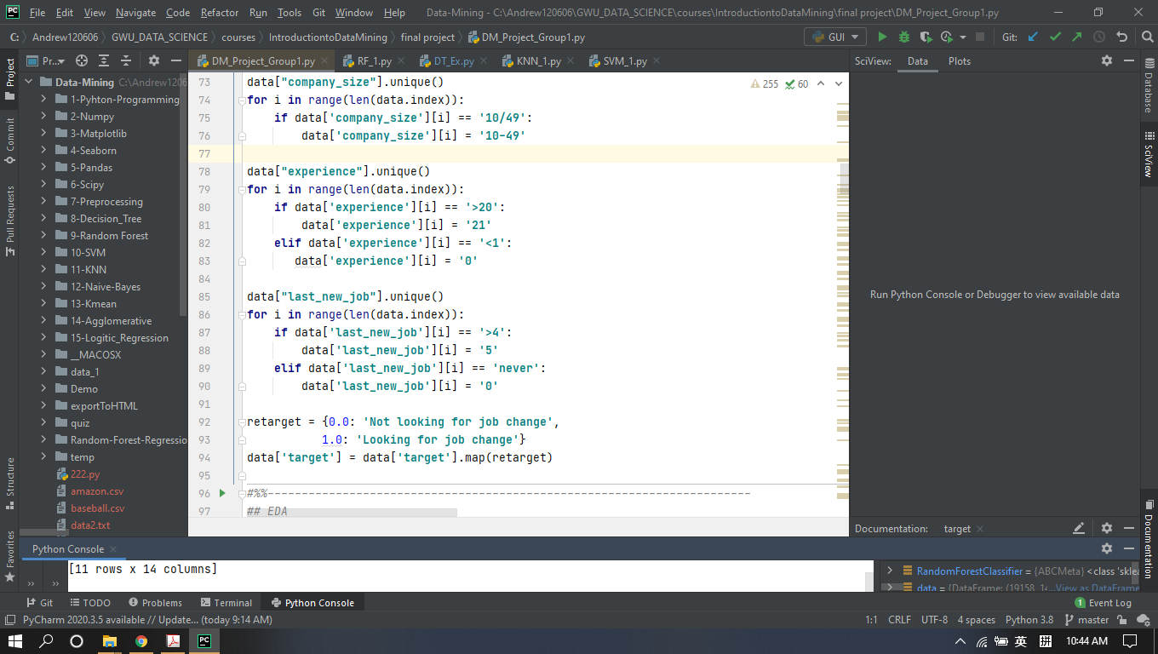
Exploratory Data Analysis
remove unrelated columns
data = data.drop(["enrollee_id","city"],axis=1)
change some values to be understood easily

Slide 7
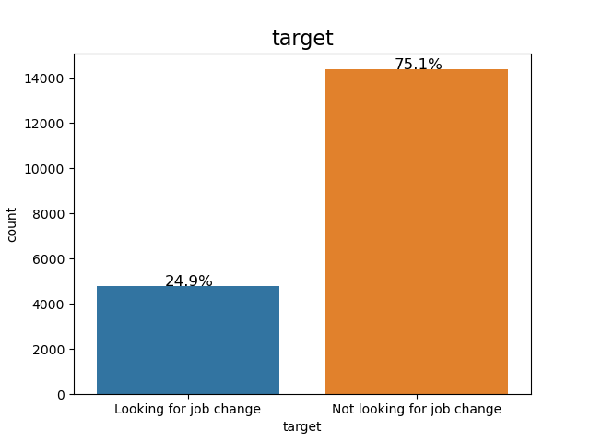
EDA - Counts for target
There are 24.9% enrollee is looking for job change and 75.1% enrollee is not.

Slide 8
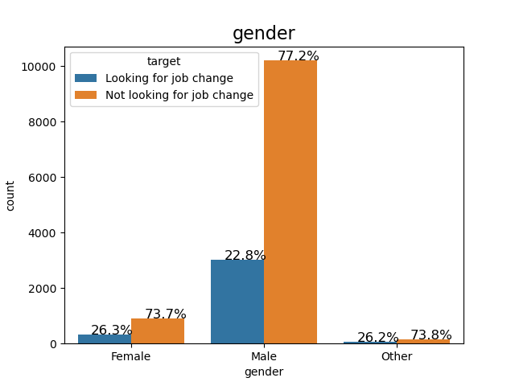
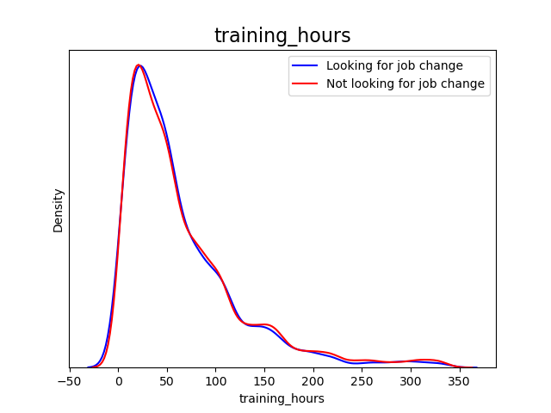
EDA - Distribution of job change by gender and training_hours
People with different gender shows comparable rate of looking for a new job.
People with different training hours shows comparable rate of looking for a new job.

Slide 9
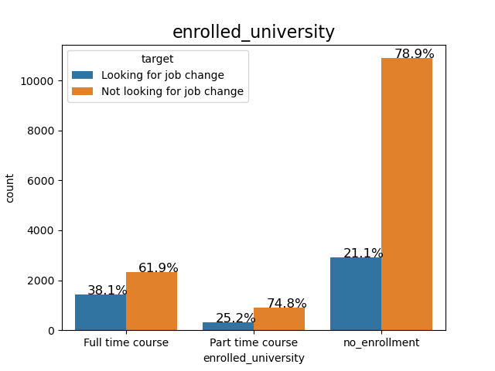
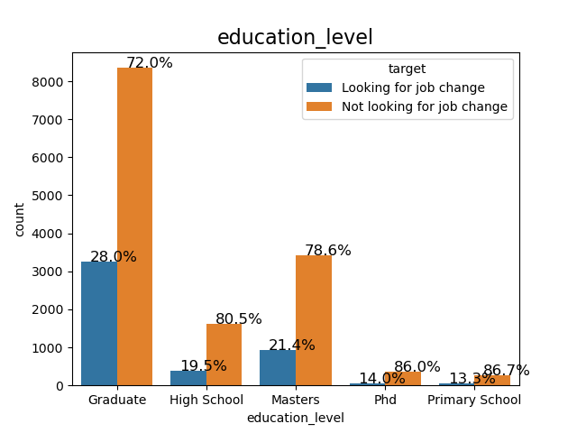
EDA - Distribution of job change by enrolled_university and education_level
People who took the full time course are more likely to look for a new job compared to others.
People with graduate education level are more inclined to look for a new job.

Slide 10
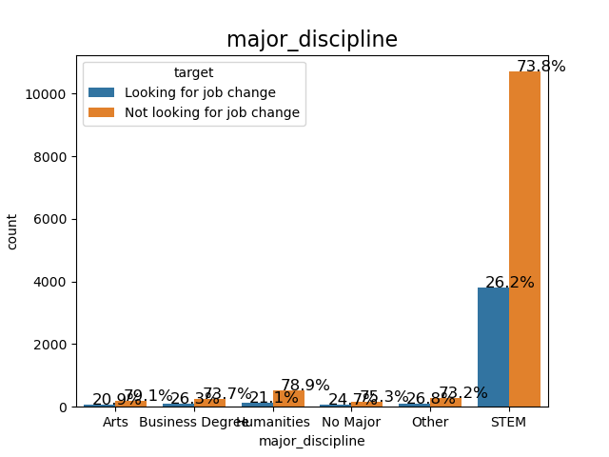
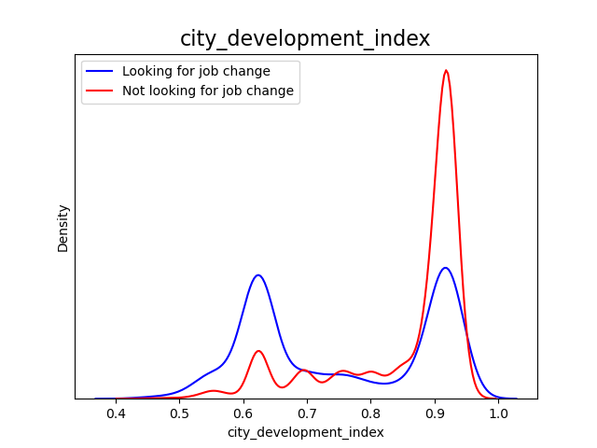
EDA - Distribution of job change by major_discipline and
city_development_index
People with different major discipline shows comparable rate of looking for a new job.
In the cities with lower city_development_index, more people is likely to look for a new job.

Slide 11
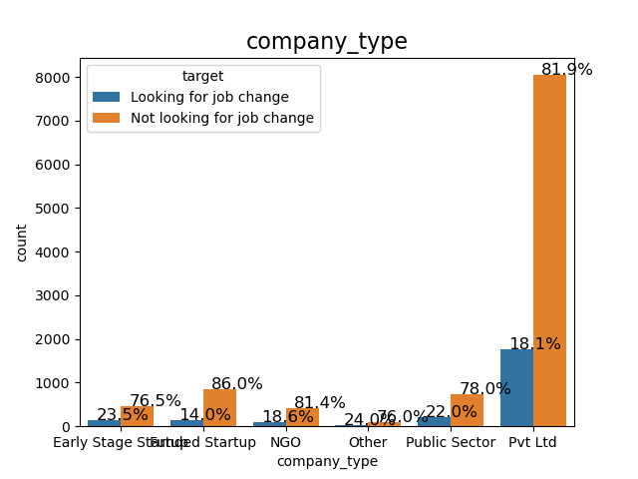
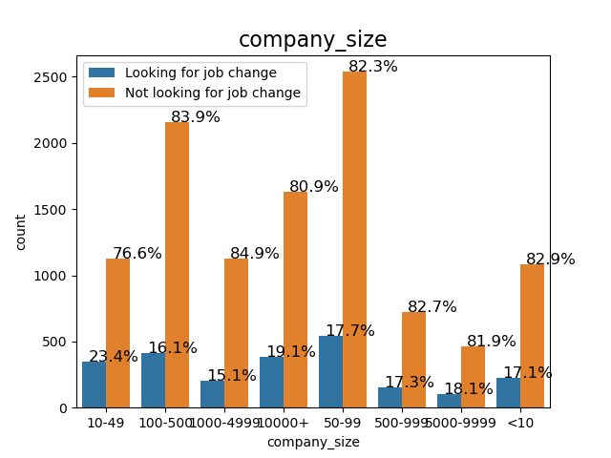
EDA - Distribution of job change by company_type and company_size
People working in the Pvt Ltd, NGO and Founded Startup are less likely to look for a new job.
People working in the company with size of 10-49 are more inclined to look for a new job.

Slide 12
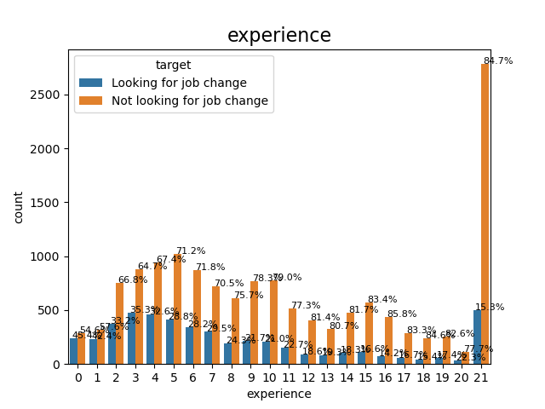
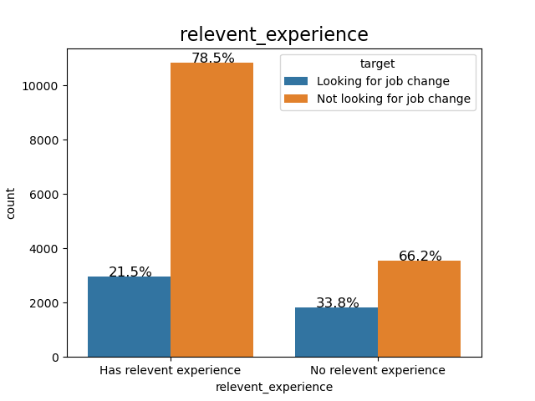
EDA - Distribution of job change by experience_years and relevent_experience
People with less working experiences and with no relevant experience are more likely to look for a new job.

Slide 13
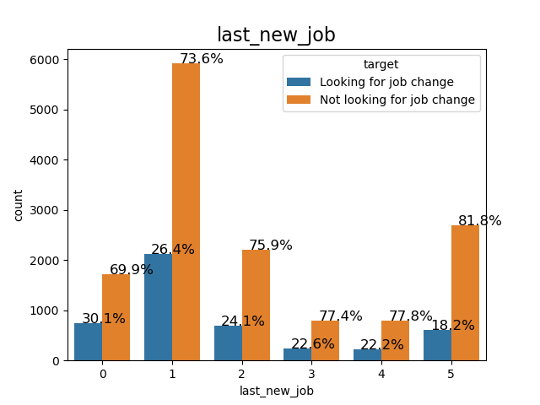
EDA - Distribution of job change by last_new_job
The difference of 1 year and zero year shows a significant higher rate of looking for a new job.

Slide 14
Data Preprocessing
specify the predictors and target variable
fill na
standardization and centralization for numerical variables with StandardScaler()
encoding categorical features with OneHotEncoder()
label target variable with LabelEncoder()
split the dataset into train (70%)and test (30%)

Slide 15
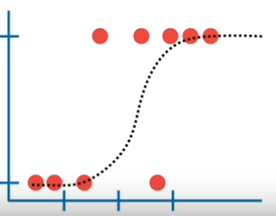

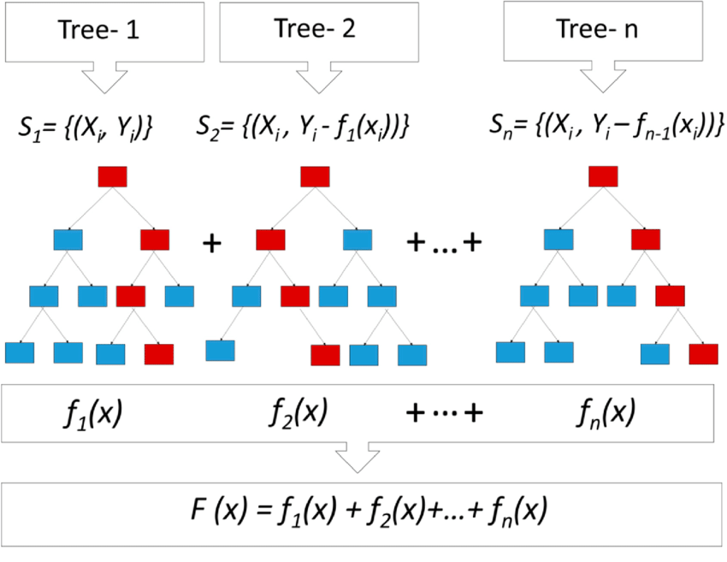
Models
Logistic Regression
Random Forest
Gradient Boosting
Notes:
When a decision tree is the weak learner, the resulting algorithm is called gradient boosted trees, which usually outperforms random forest.

Slide 16
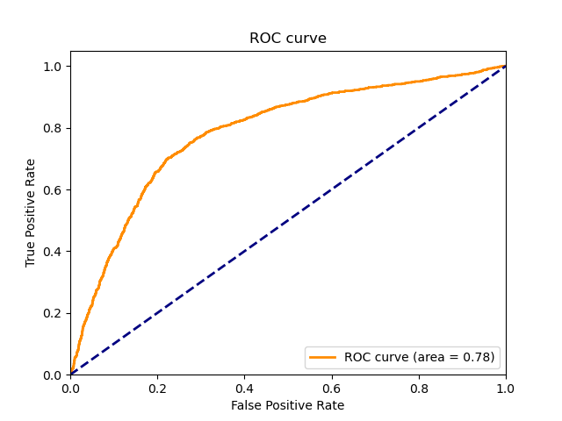
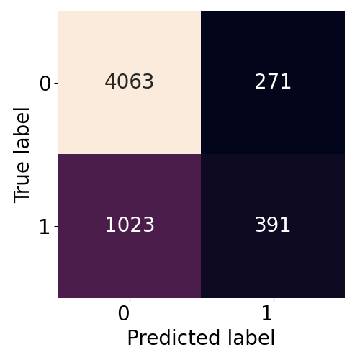
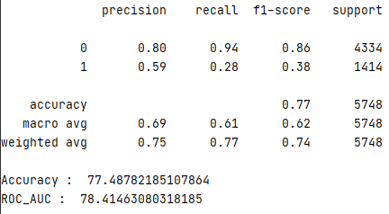
Modeling Evaluation - Logistic Regression
confusion matrix
ROC area under curve
report

Slide 17
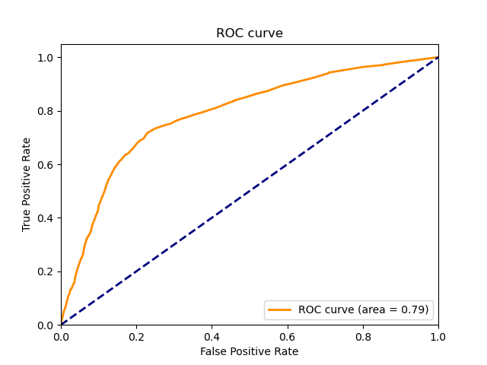
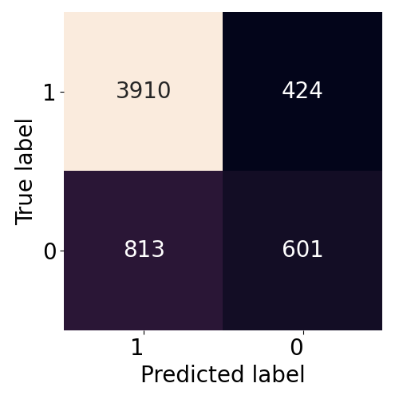
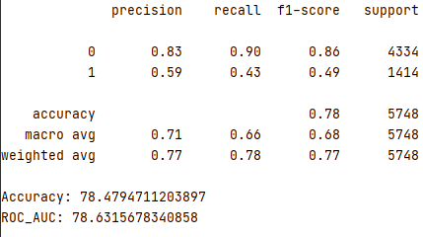
Modeling Evaluation - Random Forest
confusion matrix
ROC area under curve
report

Slide 18
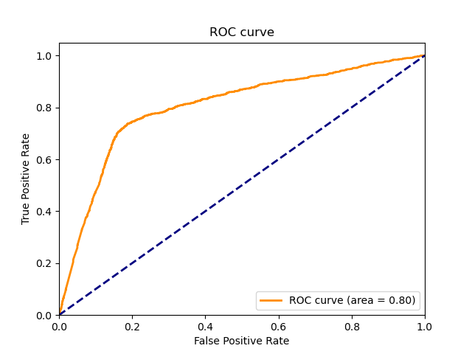
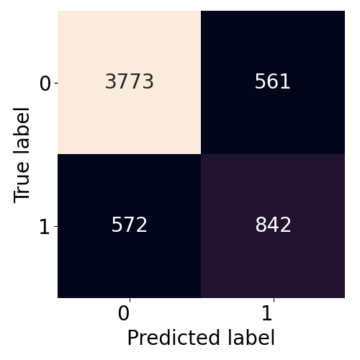
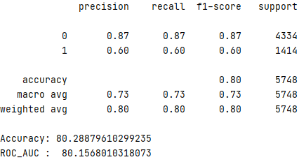
Modeling Evaluation - Gradient Boosting
confusion matrix
ROC area under curve
report

Slide 19
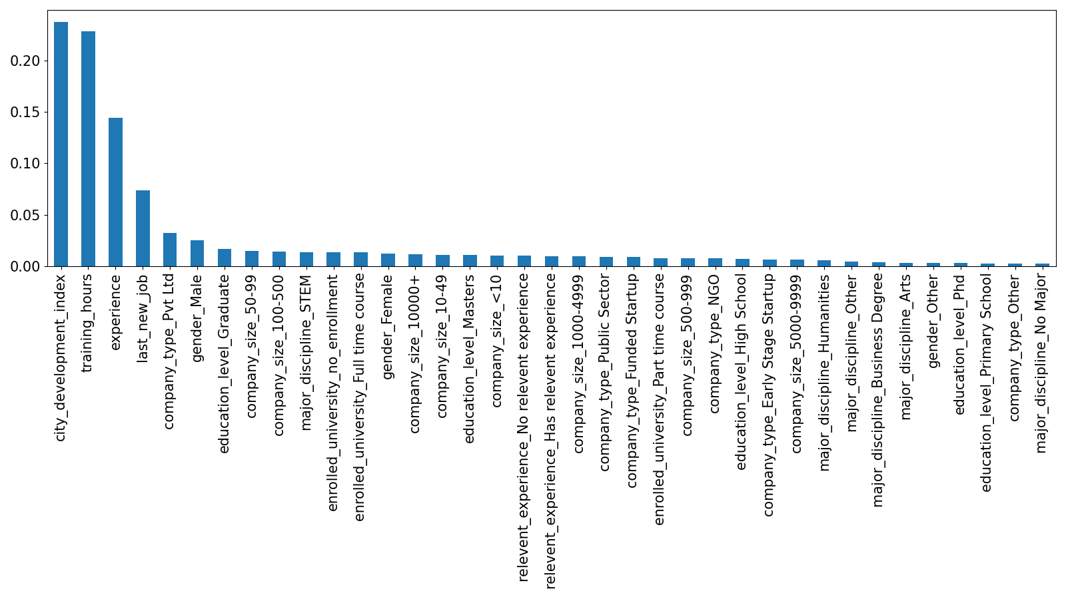
Features Importance
The top 5 important features--- city_development_index, training_hours, experience, last_new_job and company_type.

Slide 20
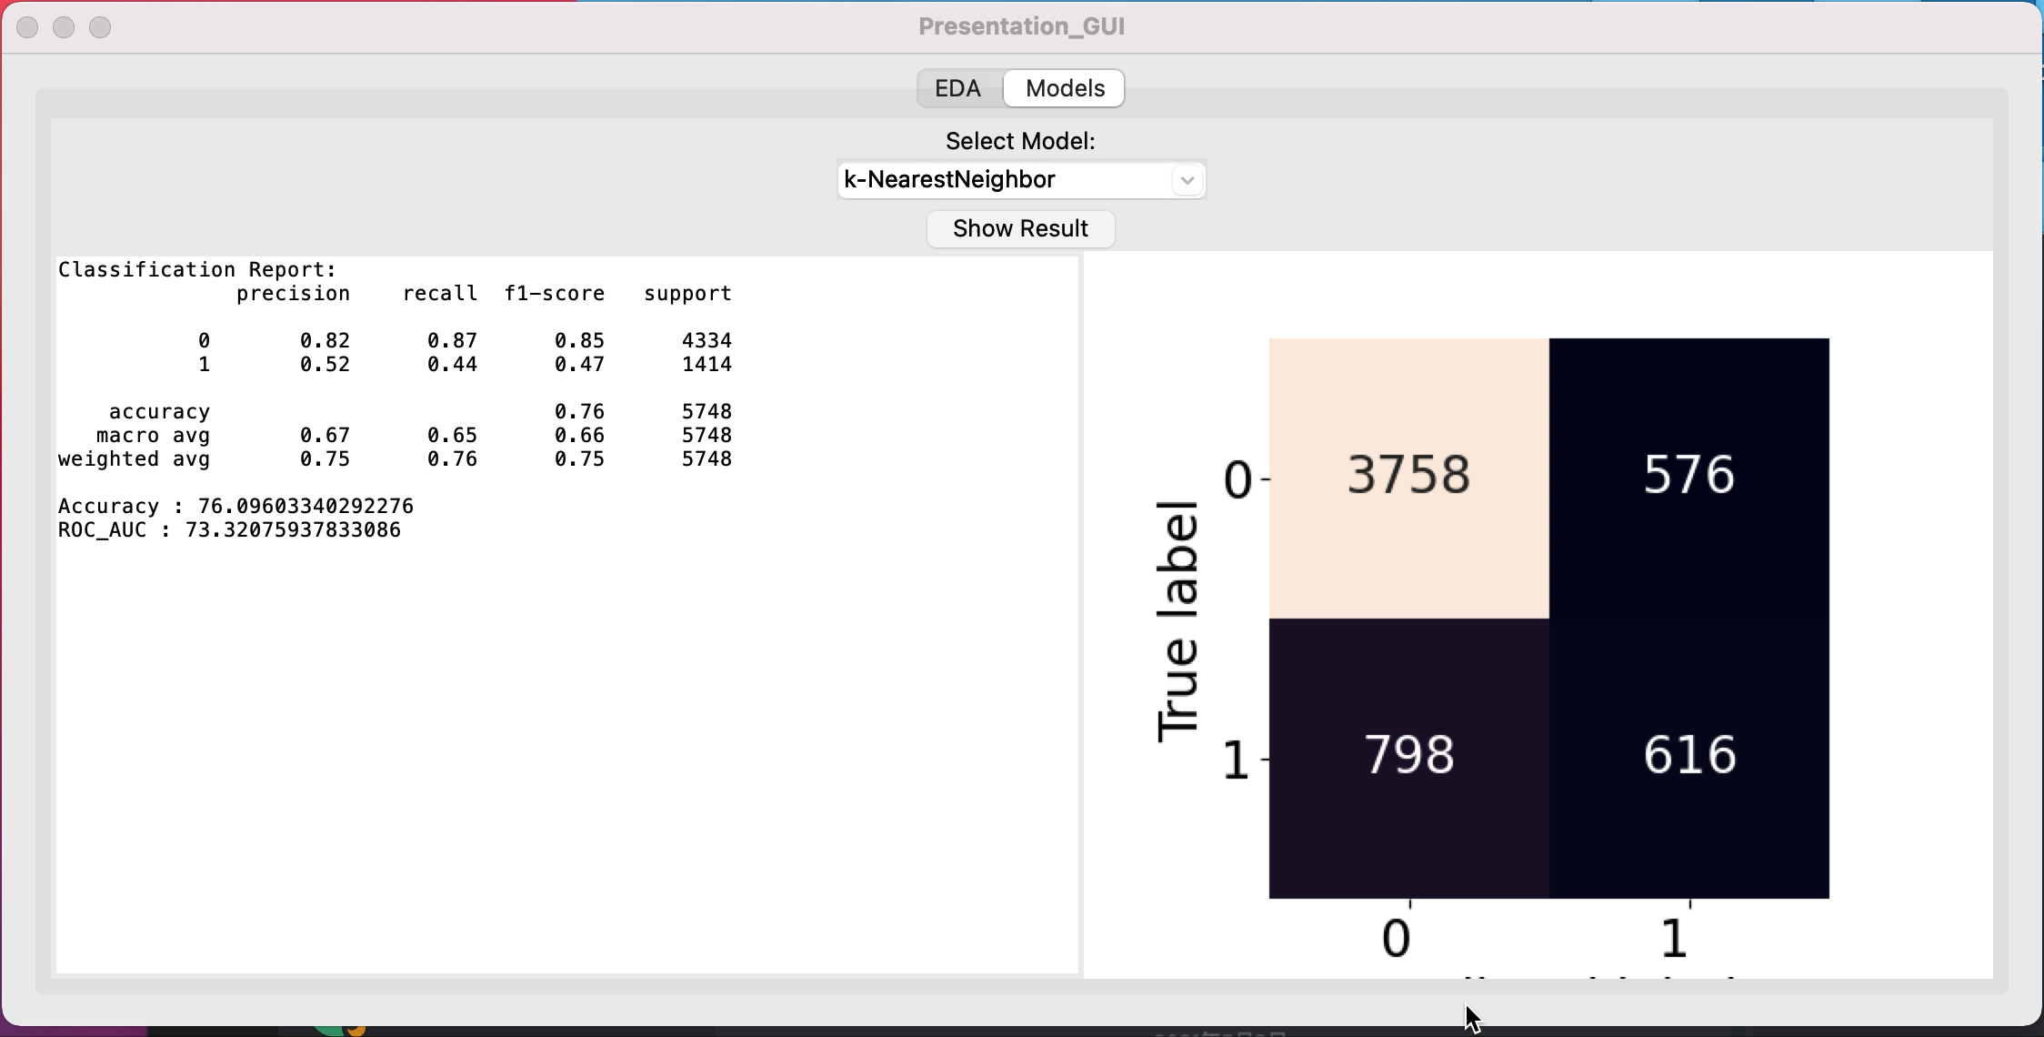
GUI

Slide 21
Summary and Discussion
Exploratory data analysis shows that city_development_index, experience, last_new_job , but not gender and training_hours, play important roles in the job change. However, feature importance shows that training_hours is the second important variable.
Based on the comparison of accuracy, f1 score and ROC_AUC, Gradient Boosting shows the best performance to predict job change.
Gradient Boosting is a great ML algorithm that handles categorical features and missing values.

Slide 22
THANKS
Q&A

